Slide 1
Automated Small Cell Size Redaction in Tableau
Tableau User Group
3.21.24

Slide 2
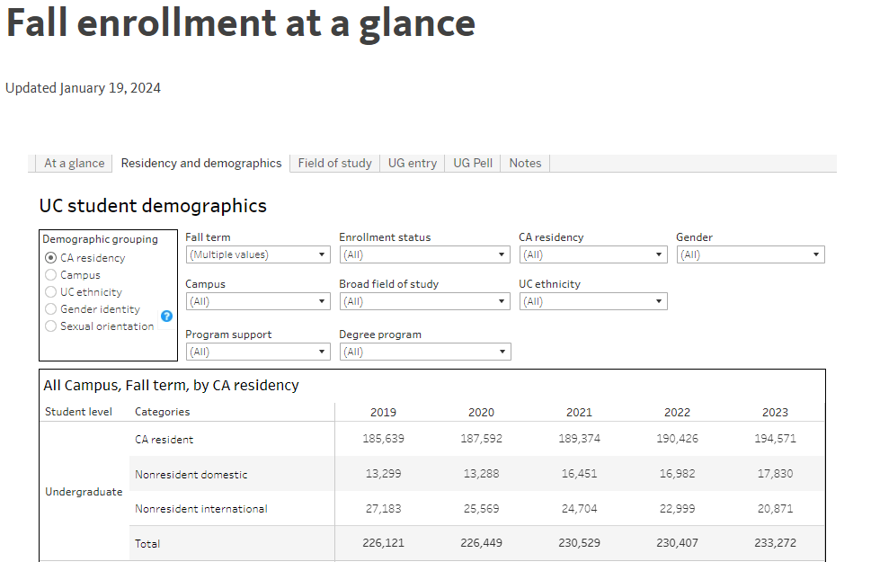
Public Facing Student Demographic Data

Slide 3
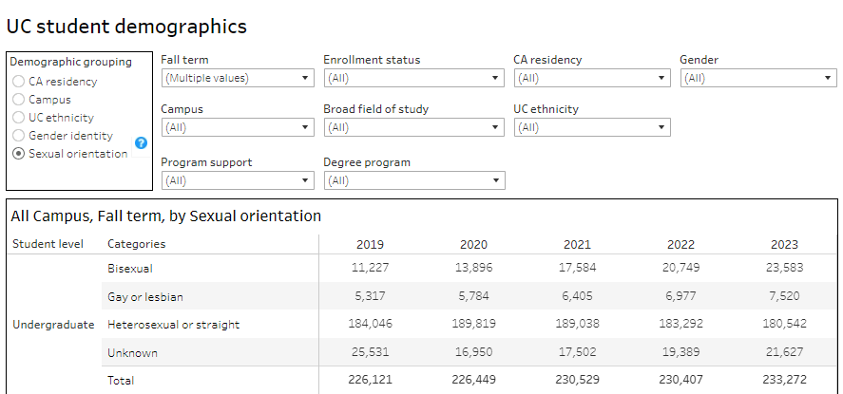
Recently Added SOGI Data

Slide 4
Requirements
Stakeholder feedback: Protect privacy with sensitive SOGI data
Targeted dashboards contain mix of sensitive and non-sensitive data
Solution must:
Redact SOGI data cells <5
Redact “next largest” cell when <5 redacted cell can be calculated from total
Operate at the column level (year) and across multiple row categories (e.g. campus and student level)
Only redact SOGI data and no redaction on any other demo data

Slide 5
Tableau Solution Step 1 – Simple Redaction
Redact cells <5
Not sufficient since missing cell can be calculated

Slide 6
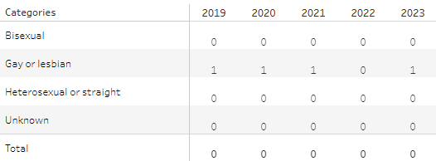
Tableau Solution Step 2 – Redact Next Largest
Create “procedural fields” to set stage for redacting the next largest cell if only one cell <5
Indicates where a <5 redaction has occurred in a column

Slide 7
Tableau Solution Step 3 – Redact Next Largest
Create “procedural fields” to set stage for redacting the next largest cell if only one cell <5
Compute the WINDOW_SUM calculation along the COLUMN field
Associates the previous redaction indicator with each cell in the column – makes future calculations easier

Slide 8
Tableau Solution Step 4 – Redact Next Largest
Create “procedural fields” to set stage for redacting the next largest cell if only one cell <5
Compute the WINDOW_SUM calculation along the COLUMN field
Ranks the values in each column to identify the redacted cell AND the next largest cell to target for redaction

Slide 9
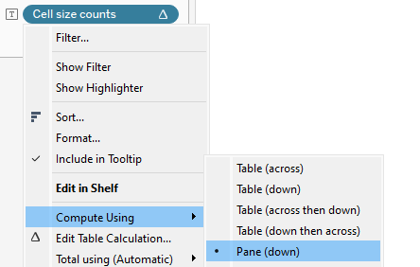
Tableau Solution Step 5 – Redact Next Largest
Create final field that redacts <5 and next largest where necessary
Compute the WINDOW_SUM calculation along the COLUMN field
<5 and next largest both redacted
Set to pane down if more than one category in column

Slide 10
Tableau Solution Step 6 – Provide Visibility
Covert redacted counts to STRING to facilitate visibility over “disappearing” populations
Compute the WINDOW_SUM calculation along the COLUMN field
Instead of NULL the redacted cells display as “<5” or “<X” rounded up to ensure privacy
<5 and next largest both redacted, but VISIBLE
Set to pane down if more than one category in column

Slide 11
The End

